Slide 1


Manual
Media Player

Slide 2
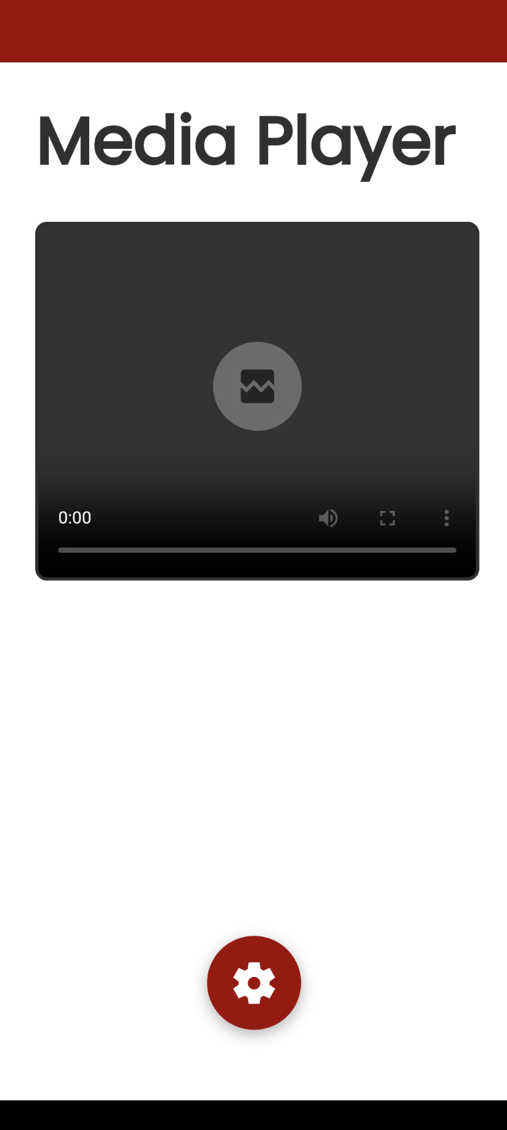
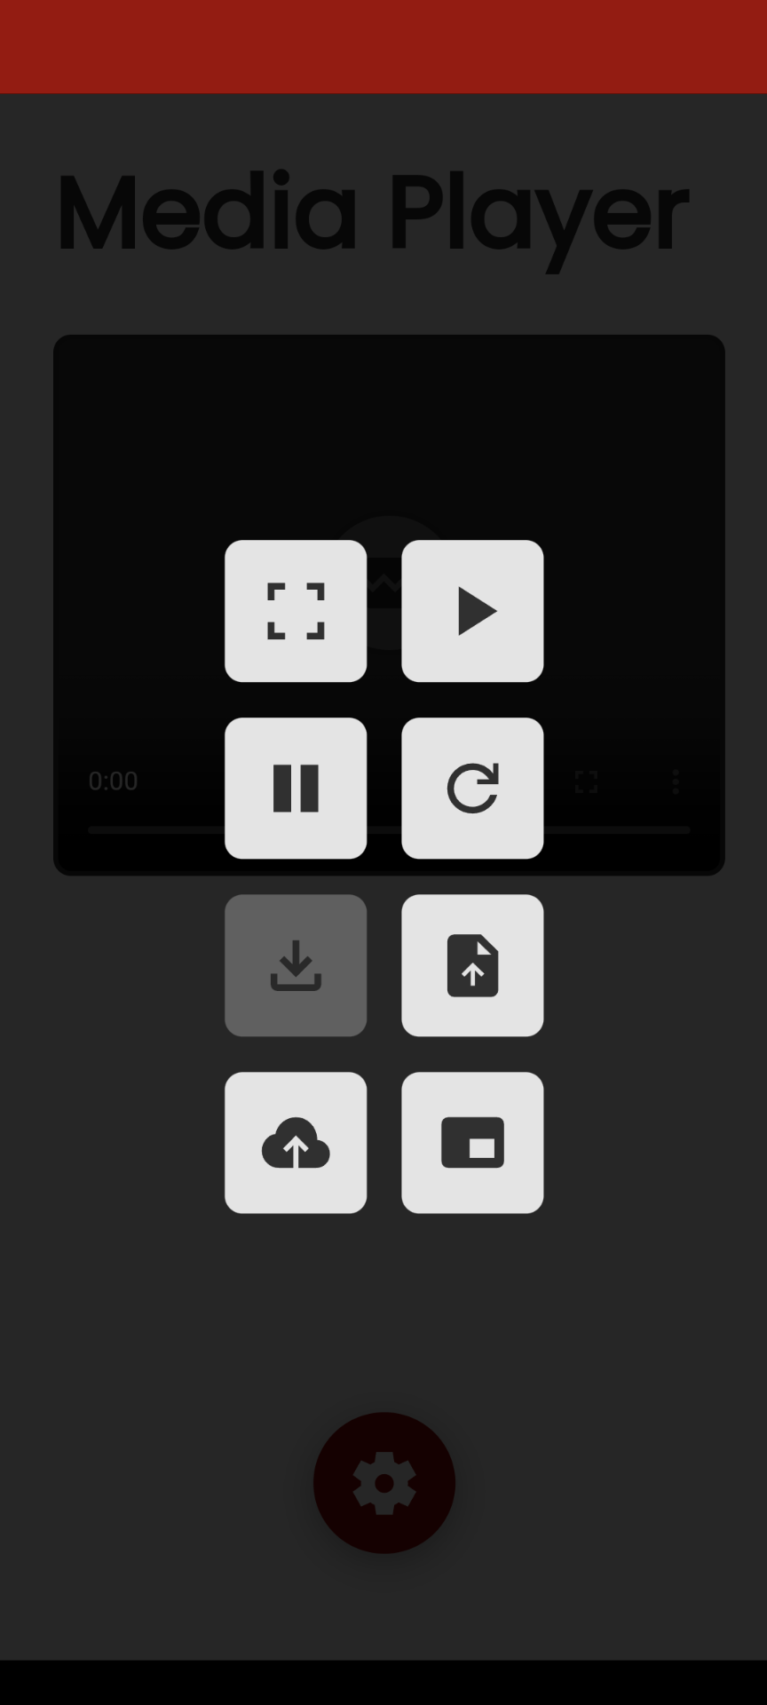
Mobile Android
App launch
Various playback control options are shown here.
App installation
Video upload from device
URL upload from YouTube
Picture-in-Picture (PiP)
Settings

Slide 3
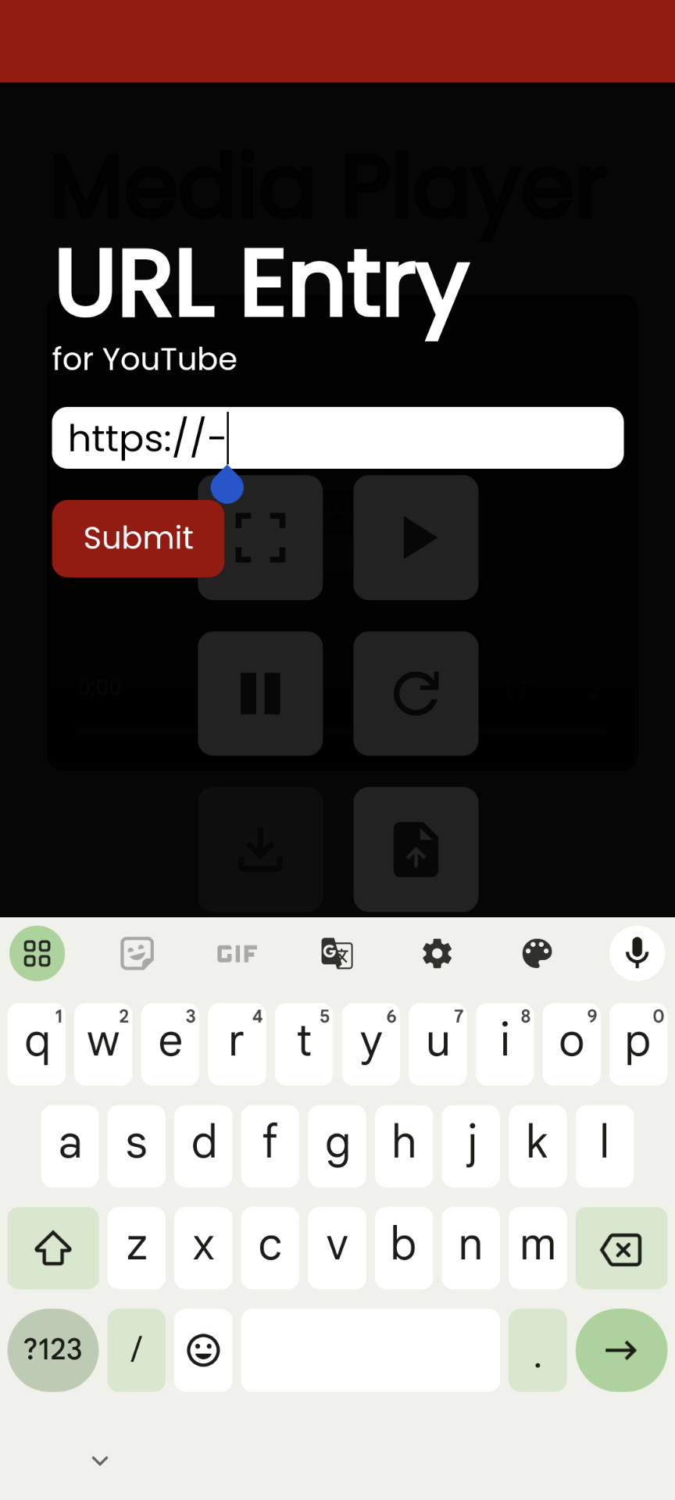
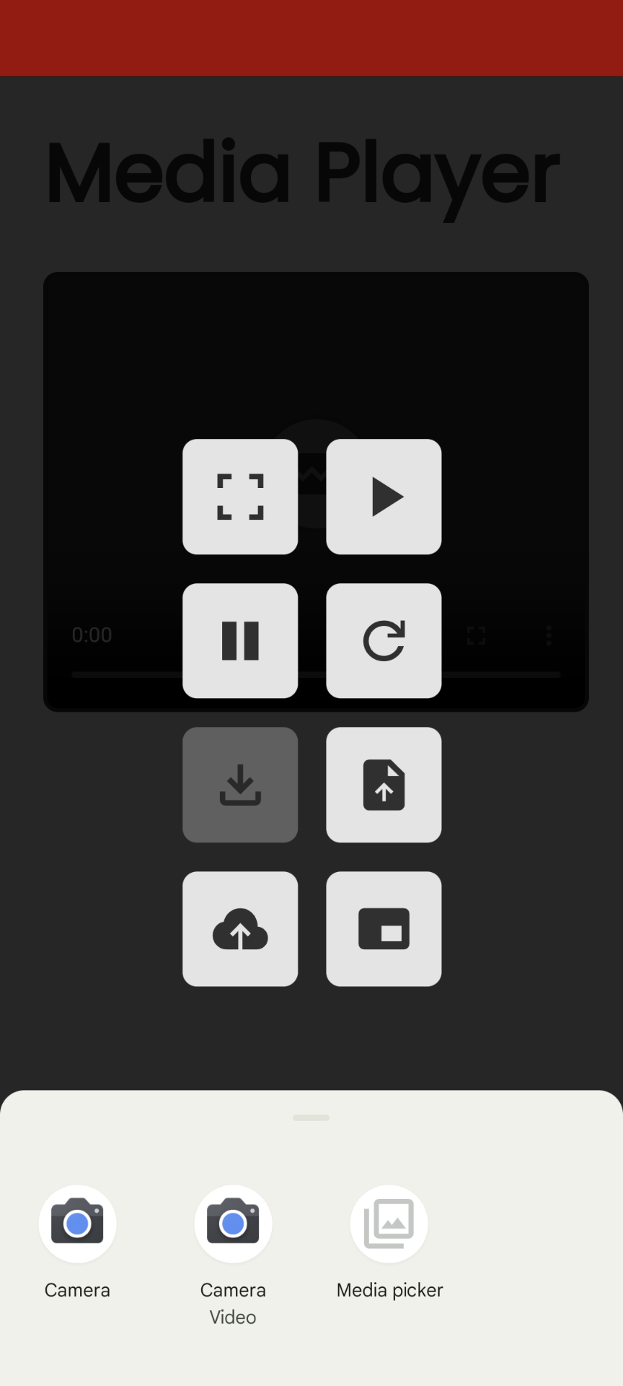
Mobile Android
URL entry for YouTube videos. Commonly occurring YouTube URLs are supported.
Video upload from device. (only ‘.mp4’, ‘.webm’ & ‘.ogg’ files are supported).

Slide 4
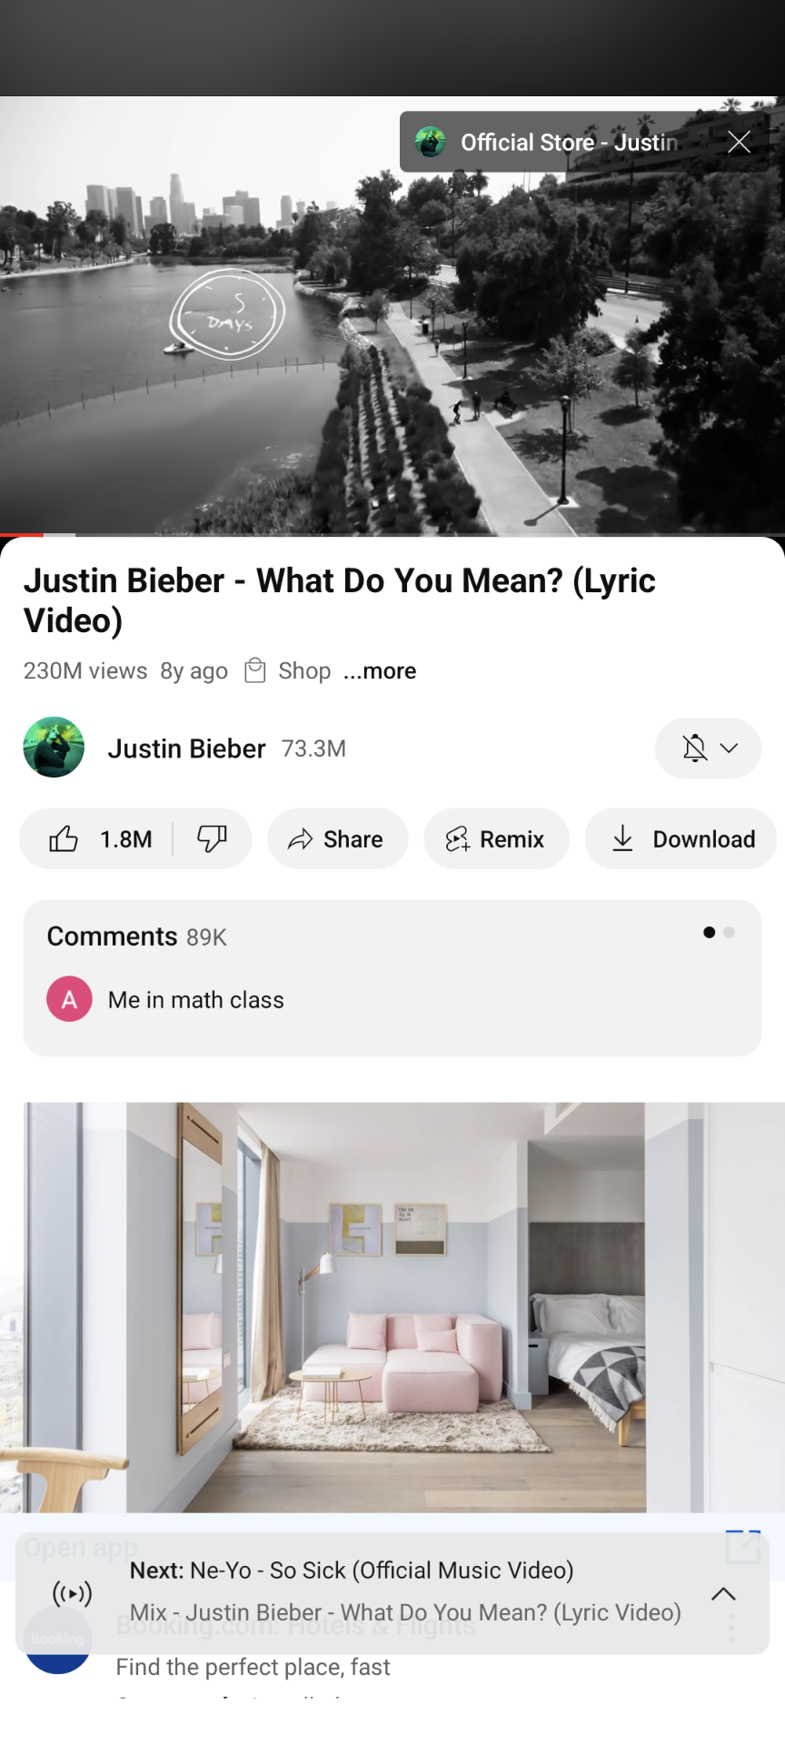
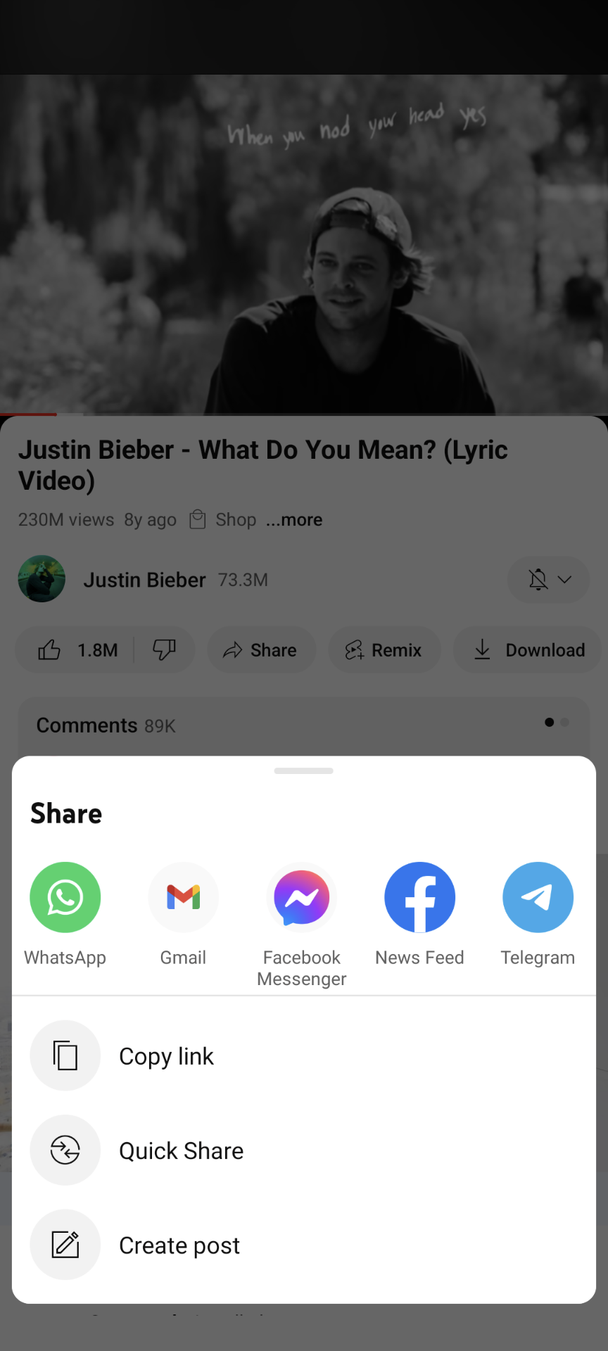
Mobile Android
Play any video on the YouTube app.
Click on the ‘Share’ button.
Copy the playback link to Media Player’s URL upload feature.
OR…

Slide 5
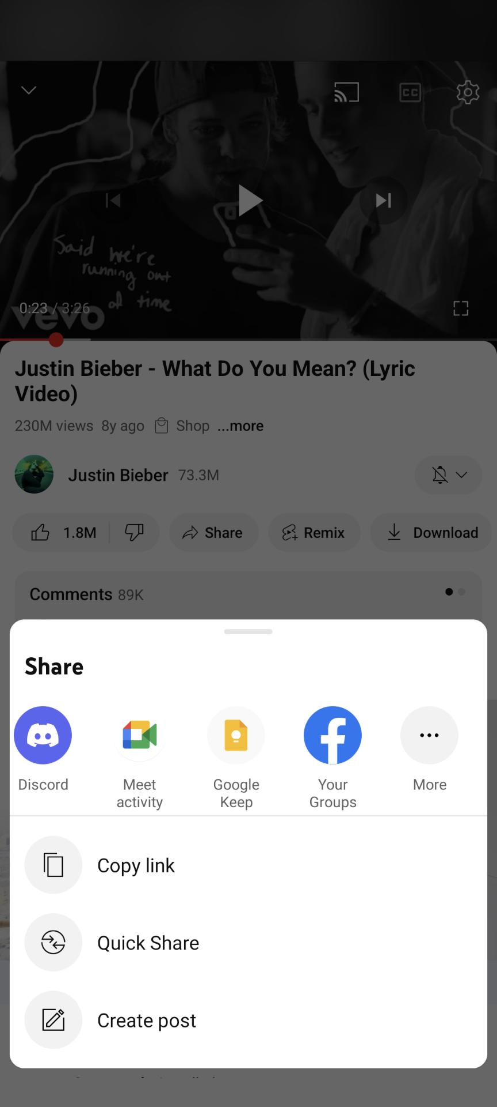
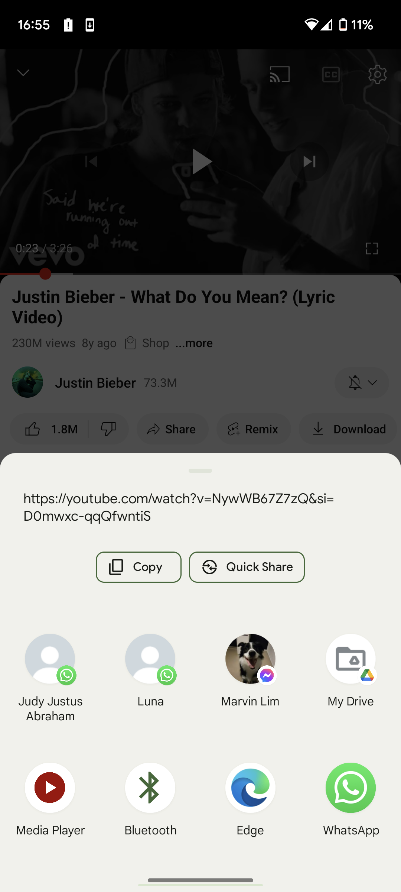
Mobile Android
Horizontally scroll across the list of options.
Find the Media Player app on the list of options.
Access more options.

Slide 6
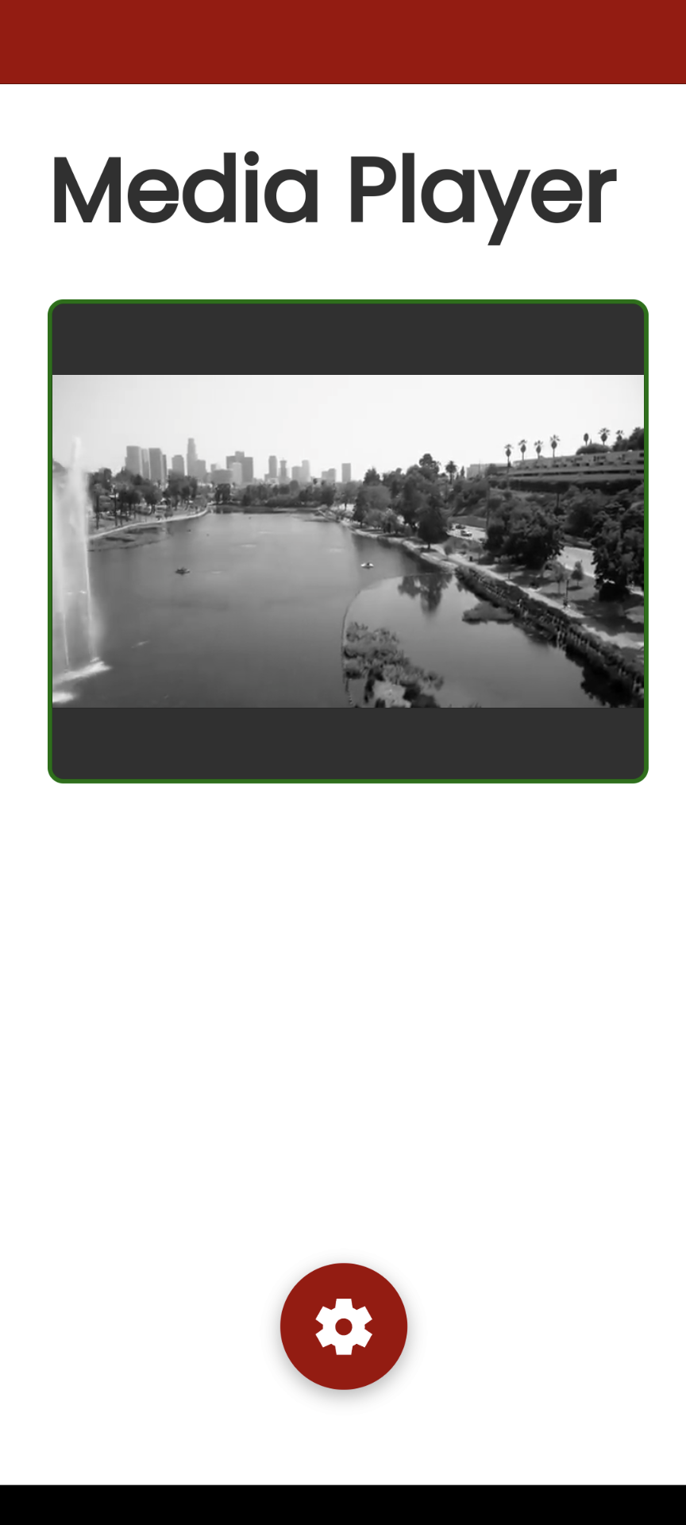
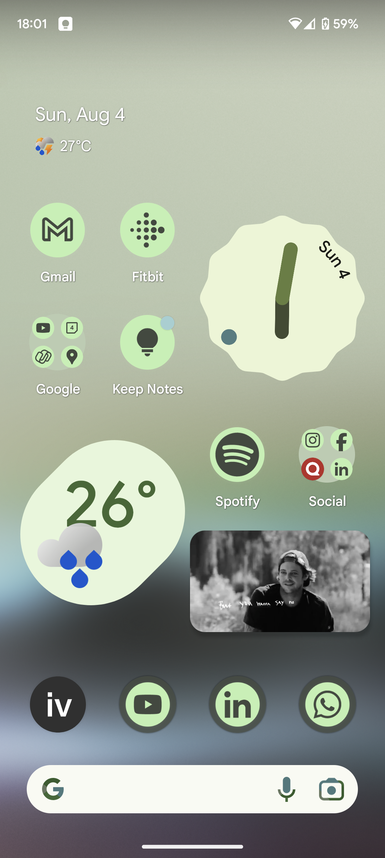
Mobile Android
The video playback loads up on Media Player.
Exit the app by accessing the home screen directly.
Video playback automatically starts on PiP mode (only if it remains running when PiP was requested).
Apply gesture interaction (by touch or click). Ensure that playback perimeter status remains ‘green’ for PiP mode.

Slide 7
Mobile Android / Desktop
Ensure that all relevant PiP settings have been enabled on your device, including permissions and privacy controls.
URL uploads are limited to a maximum of 200 universal calls per day, due to the heavy restrictions and bandwidth control put upon by YouTube servers. Further uploads might not work if this threshold has been exceeded. Additionally, playback quality remains at 360p as well.
On supported devices, background play may be manually initiated if a playback widget from the app appears in the notifications panel (or other similar locations).
Due to CORS policies, Google Ads are automatically disengaged from any playback within the app.
The uploading of non-YouTube URLs is unsupported.

